Slide 1
Project 4
Jesse Swincicki
Hector Garcia
Laura Herrera-Perafan
Justin Froehlich
Pablo Samuel Reyes
Tiffany Weller

Slide 2
Goals
Predict fluctuations in Florida’s housing market through machine learning
To achieve this, we would collect data throughout the state using numerous websites and means such as webscraping
Zillow, Redfin
Present our data in an interactive website
This goal had to be scrapped in the interest of time

Slide 3
Modules used for this project
Sqlite3: We used Sqlite3 to connect to our sqlite database
Pandas: We used pandas to read our sqlite database and reformat our data
Matplotlib: This module was used to create our charts and visualize the forecasted values
Statsmodels.ts.statespace.sarimax.SARIMAX: This module was used to build the SARIMA model and train our data
Sklearn.model: This module was used for splitting up the data into test data.
Numpy: was used for reshaping arrays in the data and generating sequences of numbers

Slide 4
Method
We utilized a machine learning technique known as SAMIRA (Seasonal Autoregressive Integrated Moving Average)
This model utilizes historical data to estimate possible patterns and trends present
These patterns inform our forecasts

Slide 5
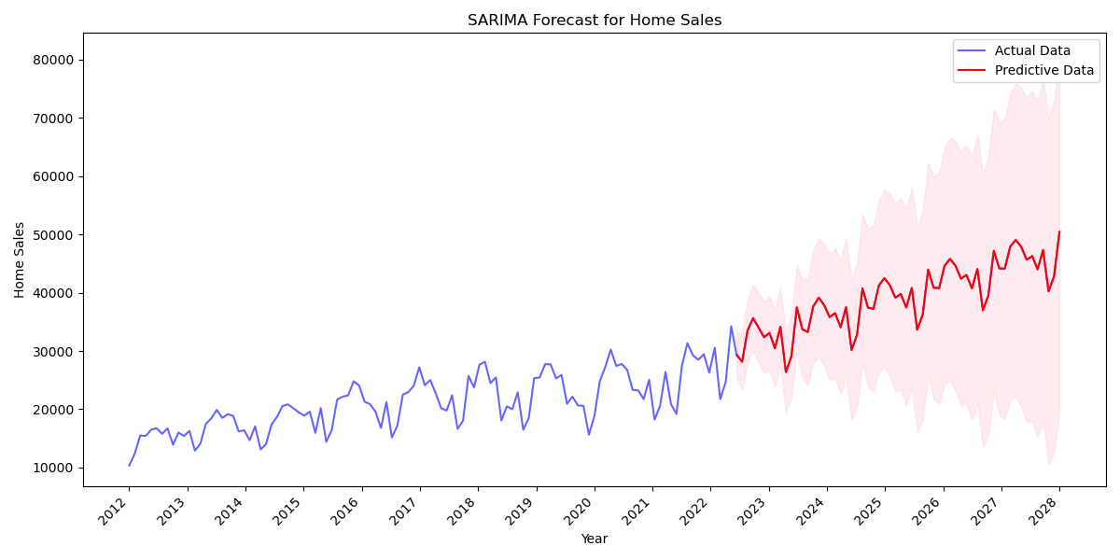
Florida Forecasted Number of Houses Sold
Predictions begin shortly after 2022.
Our model forecasts the number of houses to enter and sell within the market to increase steadily.

Slide 6
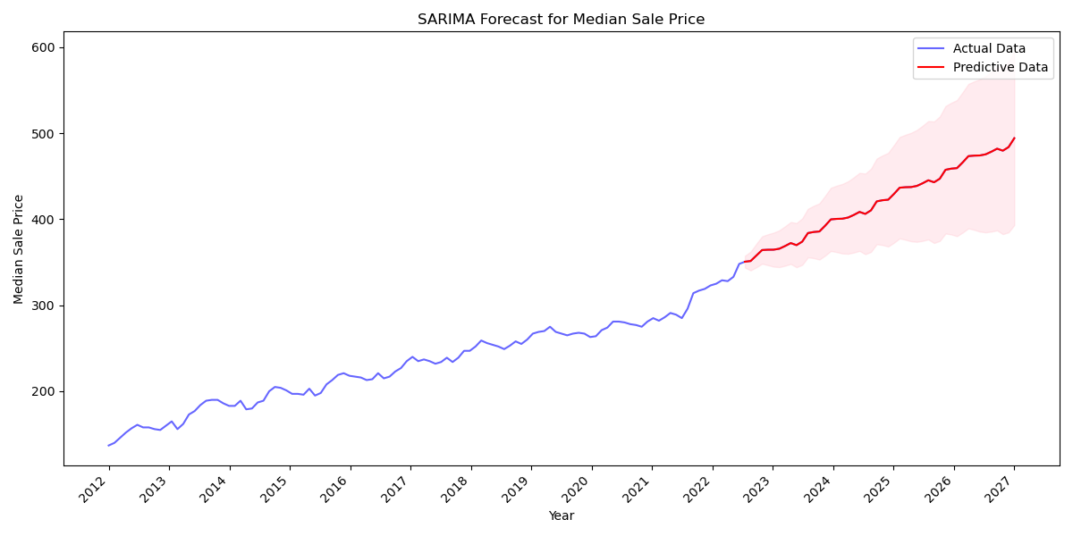
Florida Forecasted Median Sale Price ($000)
Our model predicts the median sale price for homes to continue increasing at a rapid pace.

Slide 7
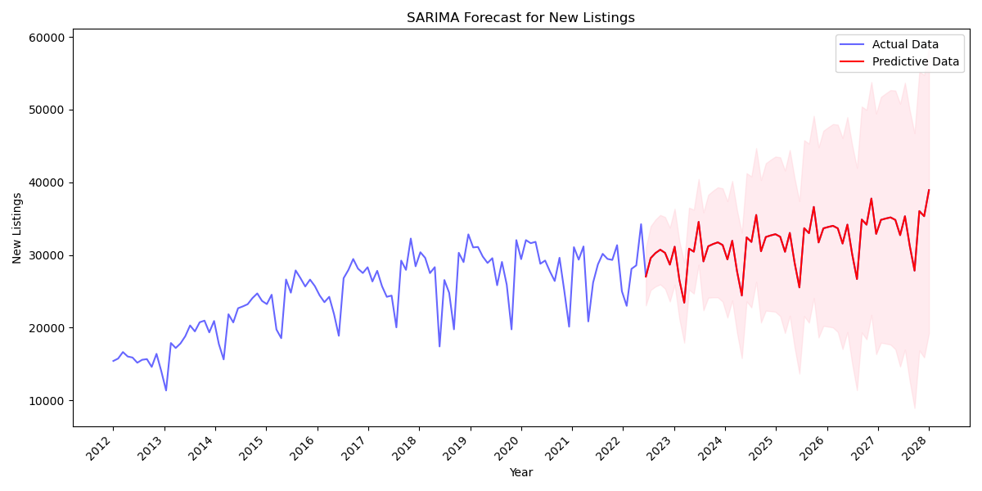
Forecasted Amount for New Listings
New listings will continue to enter the market at a fluctuating rate.
Overall, our model predicts new listings will generally increase over time.

Slide 8
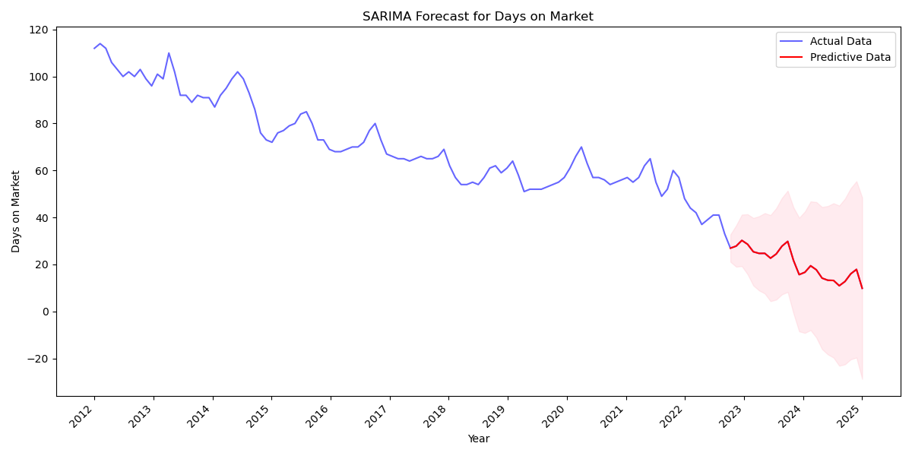
Forecasted Days on Market
Following existing trends, the average days on market for new listings will continue to decline.

Slide 9
Limitations & Improvements
Data Pulling
Difficult to find consistent Real Estate data
Real Estate APIs
Weren’t able to get the full scale of data from RedFin (Webscraping)
Time
We did not have enough time to see the full vision of the project
Knowledge
Ran into certain errors, that we couldn’t figure out
Data
Our machine learning model is very basic and there is a lot to be improved on to make the predictions more accurate.
Some more data that might be needed for this project would be more economic data such as median household income or unemployment.

Slide 10
Conclusion
Is now a good time to buy a home?
Looking at our predictive module it is showing that right now and even in the near future may not be best time to buy a home in Florida
The model does show the housing market is going up so you could say right now is a good time to make a investment but this rate of growth may be unsustainable.
Building blocks
This is a great start to what could be a much bigger project that included a lot more data to make much better predictions to really show the direction of the market in Florida
Machine learning usefulness
This project showed how useful machine learning is and will continue to be in our lives. This data can help make better informed decisions when thinking about buying a home.

